Slide 1
Molecular Biology Biol 480
Lecture 21 March 18th, 2019

Slide 2
Announcements/Assignments
Exam 2—Go over answers. Nicely done!
Topic pick due Wednesday—by 4 pm.
Real-time PCR /quantitative pcr in lab this week

Slide 3
Where were we?
RNA processing/splicing. Eukaryotes must remove introns and splice together exons from the primary mRNA transcript.
Requires nucleotide signals within the RNA as well as a ribo-protein complex--Spiceosome

Slide 4
Additional resources at NCBI (NCBI bookshelf)
http://www.ncbi.nlm.nih.gov/books/NBK9846/
READ! Some of this has been covered previously. Focus on the facts about introns in different types of organisms.
Were they present in prokaryotes and they lost them over time? Did eukaryotes evolve them independently? If so, why? Is there evidence for either/both of these ideas?

Slide 5
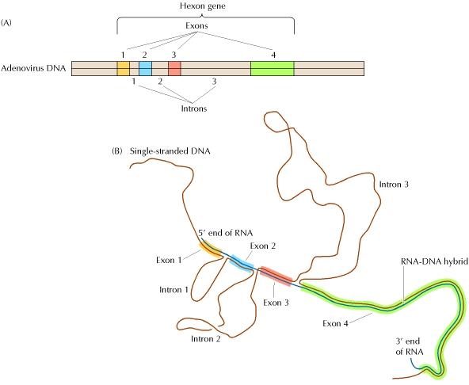
Describe this experiment. Who did it?
(from the cytoplasm)

Slide 6
What is the intron-exon boundary consensus?
Is there any other important nucleotides in the intron? In the exons?
Why is it considered a loose consensus?
How do the RNA components find the intron and guide the spliceosome to do its work?

Slide 7
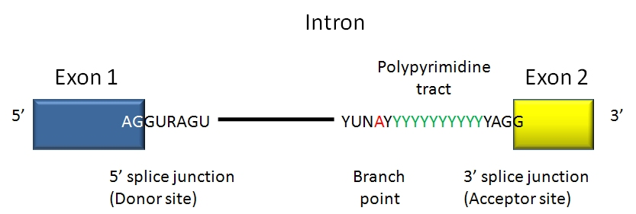

Slide 8
Components of the spliceosome
Small RNAs, found only in the nucleus, play an essential role in splicing. These “small nuclear RNAs—snRNAs, interact with small nuclear proteins to form small nuclear ribonucleoprotiens (snRNPs or snurps).
The snRNAs are rich in U and have been named “U1, U2, U3, U4, U5, and U6”

Slide 9
Different “U” snRNAs bind to different parts of the intron (by complementary base-pairing) and facilitate interactions of snRNAs and protein components of the spliceosome. The branchpoint A becomes joined to the donor site, forming a loop.
Since the loop forms with nucleotides in the middle of the intron the 3’ end of the intron extends like a tail.

Slide 10
Eventually there is a cleavage of the 3’ acceptor site which simultaneously releases the loop of intron and joins the nucleotides on either side of the intron.
The released intron resembles a lariat.
STUDY this in detail! Know the approximate order and specificity of each snRNA’s role in splicing.

Slide 11
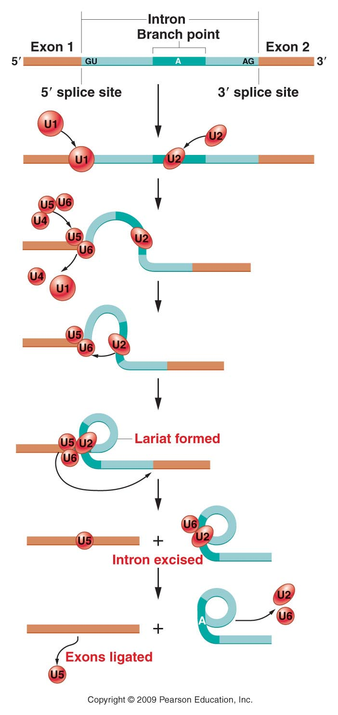
Figure 13.14
Notes:
Figure 14-14 A model of the splicing mechanism involved with the removal of an intron from a pre-mRNA. Excision is dependent on various snRNAs (U1, U2, U6) that combine with proteins to form snRNPs (snurps), which function as part of a large structure referred to as the spliceosome. The lariat structure in the intermediate stage is characteristic of this mechanism.

Slide 12
Watch animation.
http://www.dnalc.org/view/16938-3D-Animation-of-RNA-Splicing.html

Slide 13
What are self-splicing introns?
What organisms/organelles/RNAs contain them?
Who discovered them and why was it truly remarkable?
What is alternative splicing? Show/sketch an example

Slide 14
Video has no sound—good practice to identify specific factors in transcription and splicing?
http://www.youtube.com/watch?v=p2uC5j0hK0A
Alternative splicing, again, partially explains how, what appears to be a rather low number of protein coding genes in the human genome, may encode many more proteins than we first estimated. Explain!

Slide 15
How important is splicing?
Mistakes in splicing have been linked to diseases. Usually we look for mutations only in exons---why?
How might a nucleotide change in an intron cause a protein to be altered?

Slide 16
Great paper on splicing defects. Read headings and summarize. Look at table 1. Study 1 or 2 different examples of splicing-defect diseases, in detail.
https://www.ncbi.nlm.nih.gov/pmc/articles/PMC6060985/pdf/13353_2018_Article_444.pdf

Slide 17
One final post-transcriptional alteration
RNA editing
In the late 1980s, it was discovered that a few eukaryotic RNAs had slightly different nucleotide sequence than the DNA from which they were derived.

Slide 18
The changes seemed to be both:
Substitutions---changing one nucleotide to another.
AND
--Insertions or deletions of RNA nucleotides
This was thought to be impossible, since the central DOGMA states that genes are the recipe for proteins. mRNA was thought to be an exact RNA copy of a gene transcribed exactly from the DNA.

Slide 19
RNA editing was first studied in a protozoan, parasite, Trypanosoma, which causes a disease called African Sleeping Sickness.
Special RNAs called a “guide RNA”/gRNAs seems to direct the editing by binding to complementary RNA and directing editing enzymes to insert short stretches of RNA.

Slide 20
We will discuss an example of RNA editing in a mammalian gene/RNA for Apolipoprotein B.
This protein is routinely measured in medical testing for its link to heart/vascular health and disease. It is considered a Low denistity lipoprotein (LDL). It is sometime called the “bad cholesterol” component. People with blocked arteries may have high LDL levels.

Slide 21
Great summary of cholesterol!
http://www.nhlbi.nih.gov/health/health-topics/topics/hbc

Slide 22
It appears that the Apo-B mRNA is altered at a specific C nucleotide which gets changed to U.
This editing only occurs in small intestine cells and results in a shorter version of the protein and which changes its function of fat absorption in these cells.

Slide 23
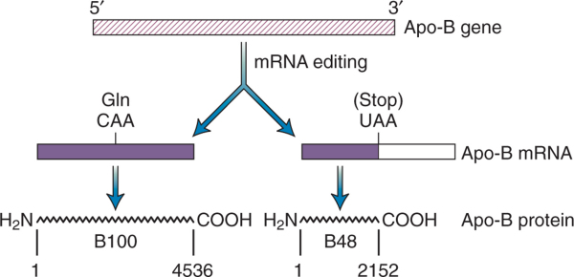
Important in small intestine cells

Slide 24
Speculate on how RNA editing was discovered? Think about ApoB as an example.
Read more on your own. Google!

Slide 25
Gene expression…Part 2
Translation!
Despite the important roles we’ve discussed for RNA, we can’t underestimate the importance of proteins in cells.
Proteins are translated from mRNA which is transcribed from genes in DNA.

Slide 26
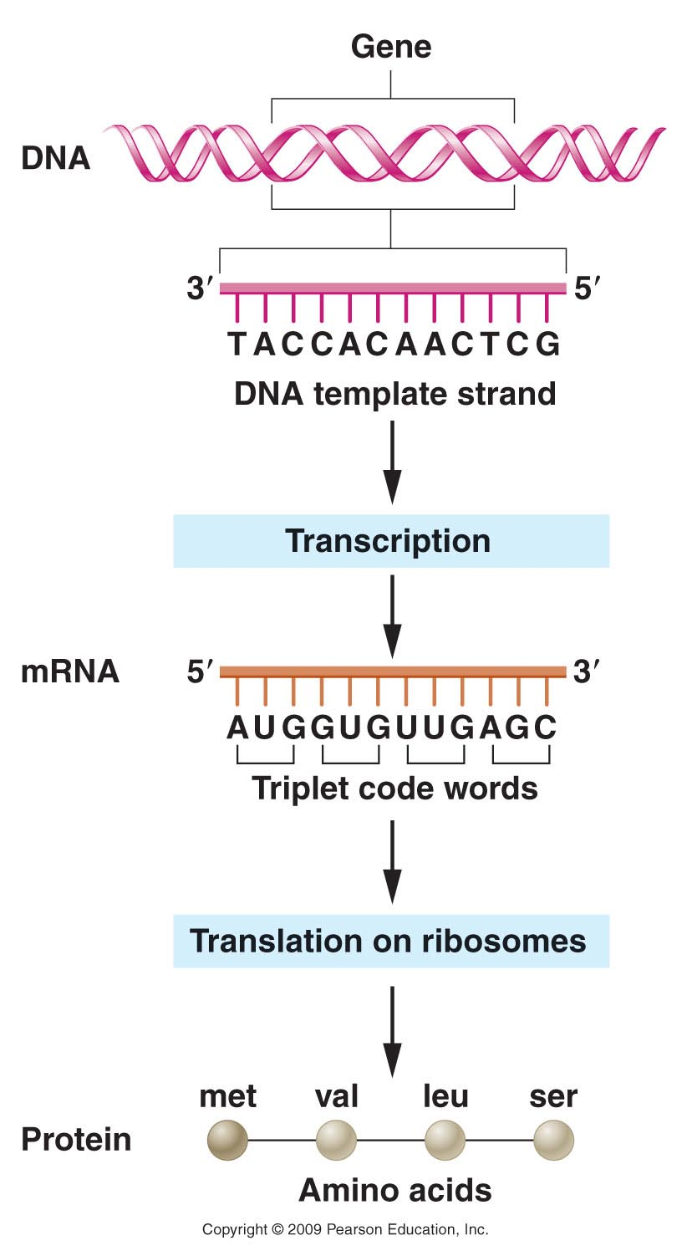
Figure 13.1
Notes:
Figure 14-1 Flow of genetic information encoded in DNA to messenger RNA to protein.

Slide 27
Again, a number of scientists established the mechanism for translation, using a combination of biochemical, and molecular biology approaches.
Details of the mechanism of translation were established during the 1960s and involved many scientists.

Slide 28
The knowns…
Biochemists had studied both nucleic acids and proteins and had established:
DNA is made of linear sequence of 4 different dNTPs ( A, T, C, G)
Proteins are more complex, in that they are built using 20 different amino acids.

Slide 29
Despite many attempts to link DNA directly to protein synthesis, several scientists, including Francois Jacob, and Jacques Monod, hypothesized that an intermediate molecule was necessary to produce a protein from a DNA code.

Slide 30
We’ve learned already that the intermediate was mRNA transcribed from the DNA (gene) sequence.
Read again how scientists discovered mRNA using bacteria and bacteriophages. (13.9)
How did scientists show sequence similarity before we were able to sequence DNA?

Slide 31
Once it was established that mRNA held the actual code for protein synthesis, lots of experiments were done to show how the code worked.
mRNA, like DNA is made with 4 different building blocks NTPs (U, C, G, A)
Sydney Brenner proposed, based on the numbers of building blocks in both types of molecules, a 3-letter RNA code, would be sufficient to encode 20 amino acids.

Slide 32
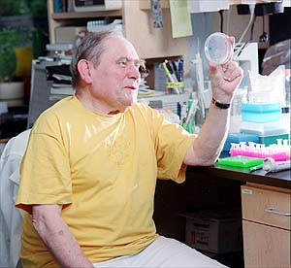
Sidney Brenner was in the James Watson video you watched.

Slide 33
The “extra” codes suggested a possibility for redundancy, that one amino acid might have more than one 3-letter designation.
Later, the code was show to be degenerate. The actual nature of the degeneracy, helped establish details of the translation machinery.

Slide 34
One of the first pieces of evidence supporting a triplet code used bacteriophages (go figure?) and a method for creating insertion or deletions of nucleotides in the genes of the phage.
It was noticed that inserting or deleting one nucleotide usually wiped out the normal activity of a gene—it created a non-functional mutant.

Slide 35
The same occurred if 2 nucleotides were inserted or deleted.
But if 3 or multiples of 3 nucleotides were inserted or deleted, the mutations were often reversed, and at least in some cases, a wild-type phenotype was restored.
This was consisted with the 3-letter code proposed by Brenner. Adding or subtracting 3 nucleotides has only limited effect on how a mRNA is translated.

Slide 36
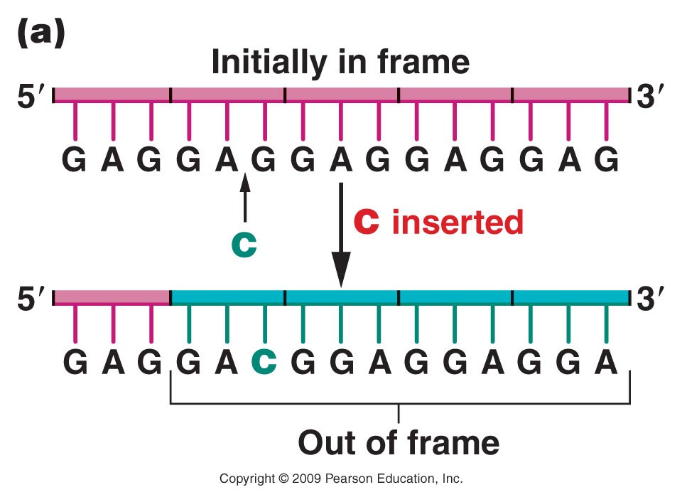
Figure 14.2a
Notes:
Figure 14-2a The effect of frameshift mutations on a DNA sequence repeating the triplet sequence GAG. (a) The insertion of a single nucleotide shifts all subsequent triplet reading frames. (b) The insertion of three nucleotides changes only two codons, but the frame of reading is then reestablished to the original sequence.

Slide 37
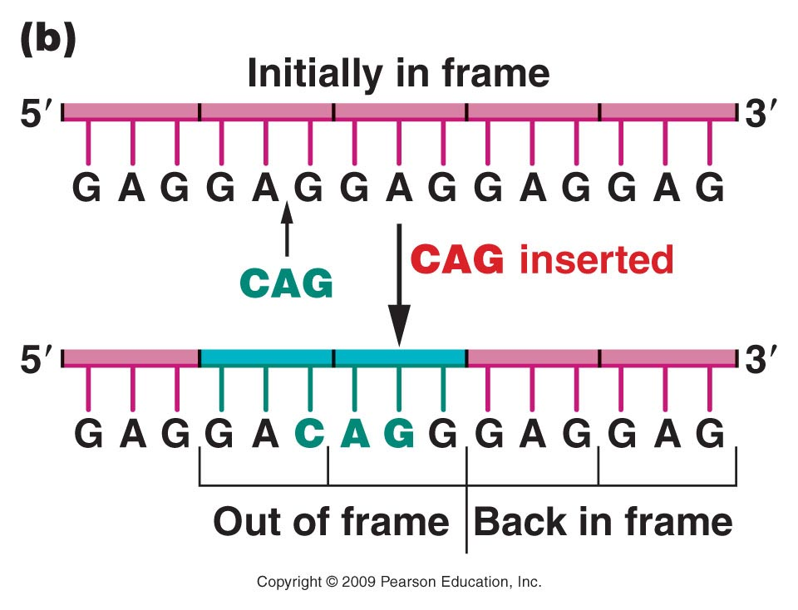
Figure 14.2b
Notes:
Figure 14-2b The effect of frameshift mutations on a DNA sequence repeating the triplet sequence GAG. (a) The insertion of a single nucleotide shifts all subsequent triplet reading frames. (b) The insertion of three nucleotides changes only two codons, but the frame of reading is then reestablished to the original sequence.

Slide 38
The term frame-shift has been used to describe mutations which alter the way in which a triplet code is read in translation.

